Slide 1

FUTURE AGRI:
THE NEXT GENERATION OF AI ENABLED SMART FARMING
GUIDED BY
Ms. Febin Rani L(AP/CSE)
TEAM MEMBERS
AKSHAYA M V (960321104012)
ANISHA M (960321104013)
ANJUSHA S (960321104014)
AYARIN JUSME J V (960321104022)

Slide 2
Abstract
Smart farming is an innovative approach that leverages ML and the Internet of Things (IoT) to optimize agricultural processes. Traditional farming methods often result in inefficient resource utilization, unpredictable yields, and susceptibility to environmental changes. This project aims to enhance precision agriculture by integrating IoT sensors, real-time data analytics, and predictive modeling to monitor and improve farming operations.
IoT sensors collect real-time data on soil moisture, temperature, humidity, and crop health, which is then processed using machine learning algorithms to predict crop yield, detect diseases, and optimize irrigation schedules. Cloud-based data processing ensures large-scale data storage and trend analysis, enabling data-driven decision-making. Additionally, the system provides automated alerts and recommendations to farmers, helping them take proactive measures against pest infestations, adverse weather conditions, and inefficient resource use.
The implementation of DL-driven smart farming leads to increased productivity, reduced operational costs, and sustainable agricultural practices. By integrating advanced AI-powered decision-making, this project contributes to food security, efficient resource management, and environmental conservation, making agriculture more resilient and technology-driven.

Slide 3
Introduction
Traditional farming methods often rely on manual observations and generalized agricultural practices, leading to inefficient resource utilization, unpredictable yield outcomes, and vulnerability to pests and diseases. This project integrates Machine Learning (ML) and IoT sensors to implement smart farming techniques, enabling data-driven decision-making to enhance agricultural productivity and sustainability.
Key Focus Areas:
IoT Sensor Integration – Collects real-time data on soil moisture, temperature, humidity, and crop health.
Machine Learning Models – Analyzes environmental and crop data to predict yield, detect diseases, and optimize irrigation.
Cloud-Based Data Processing – Stores and processes large-scale agricultural data for trend analysis and forecasting.
Automated Alerts & Recommendations – Sends real-time notifications on water needs, pest infestations, and weather-based advisories.
Precision Resource Management – Optimizes water, fertilizer, and pesticide usage, reducing waste and maximizing efficiency.

Slide 4
LITERATURE SURVEY
Title | Authors | Method Used | Pros | Cons
Estimation of Crop Yield From Combined Optical and SAR Imagery Using Gaussian Kernel Regression | Y. Alebele et al. (2021) | Gaussian Kernel Regression combining Sentinel-2 vegetation indices and Sentinel-1 SAR data | Utilizes limited ground truth data; Synergetic use of SAR and optical data | Dependent on quality of input data; Complexity in handling dual-source data
Efficient Smart Farm System Using ML | Rashmirani Samantaray et al. (2023) | Automation using Raspberry Pi and sensors for livestock monitoring | Reduces manual labor; Enables smart farm automation | Limited scalability; Power and sensor maintenance needed
IoT Approach to Crop Health and Growth | V. Grimblatt et al. (2021) | IoT-based ADMS with medium-cost sensors | Affordable and real-time monitoring; Promotes sustainability | Network dependency; Sensor calibration needed
IoT and ML in Agriculture | P. Shankar et al. (2024) | Comparative study using deep learning and ML in smart farming | Improves yield and water use; Enables disease detection | Varying accuracy based on algorithm; Need for sensor infrastructure
AAVI: Leaf Nitrogen Estimation in Rice | W. Wang et al. (2021) | Abundance Adjusted Vegetation Indices (AAVI) using UAV imagery | Works at early/middle rice stages; Improves nitrogen estimation | Limited to multispectral UAVs; Complex spectral unmixing
Object-Based Mapping of Crop Coverage | Z. Tang et al. (2020) | Multiscale object-based weighted method using GF-2 imagery | Accurate mapping using ensemble learning; Reduces field visits | Difficulty in scale parameter selection; Manual digitization required

Slide 5
Existing System
Traditional machine learning (ML) techniques have been extensively used in precision agriculture to analyze farm data and enhance decision-making.
These techniques help in crop classification, pest detection, yield prediction, and resource optimization. Some of the widely used approaches include:
Support Vector Machines (SVM)
Used for crop classification, pest detection, and disease identification based on image data.
Effective in detecting patterns in plant health but requires manual feature extraction and struggles with high-dimensional data.
While these techniques provide useful insights, they often struggle with handling large-scale, high-dimensional data, requiring manual feature extraction and offering limited accuracy in complex agricultural environments.

Slide 6
Disadvantages
Manual Feature Engineering
Limited Scalability & Generalization
Struggles with High-Dimensional Data
Lower Accuracy in Complex Scenarios
Static Nature & Lack of Real-Time Learning
Computational Limitations & Processing Speed
Lower Performance in Image-Based Applications

Slide 7
Proposed System
The proposed system enhances traditional ML techniques by integrating Deep Learning (DL) for higher accuracy, automated feature extraction, and real-time decision-making. Key advancements include:
Convolutional Neural Networks (CNNs)
Used for image-based disease detection in crops.
Can analyze leaf images to identify diseases like fungal infections or nutrient deficiencies.
Enhances precision in pest detection using drone or camera-captured images.
Long Short-Term Memory (LSTM)
Applied for time-series analysis of sensor data (temperature, humidity, soil moisture).
Predicts future weather conditions, irrigation needs, and potential risks of crop failure.

Slide 8
Advantages
High accuracy in image-based classification tasks.
Automated feature extraction, reducing manual effort.
Scalable for large datasets collected from drones and IoT cameras/Sensors
Handles sequential & time-series data efficiently.
Learns long-term dependencies, making it useful for weather & crop predictions

Slide 9
Architecture Diagram
Data Acquisition
Atmospheric Data
Soil Properties
Preprocessing
CNN Model
Convolutional Layers
Pooling Layers
Flatten Layers
Fully Connected Layers
LSTM Model
Historical Yield
Training
Labelled Dataset
Crop Selection
Yield Prediction
Fertilizer Recommendation

Slide 10
Technique/Algorithm
1. Convolutional Neural Networks (CNNs)
Used for image-based disease detection in crops.
Can analyze leaf images to identify diseases like fungal infections or nutrient deficiencies.
Enhances precision in pest detection using drone or camera-captured images.
Eliminates manual feature extraction, improving accuracy.
2. Long Short-Term Memory (LSTM)
Applied for time-series analysis of sensor data (e.g., temperature, humidity, soil moisture).
Predicts future weather conditions and irrigation needs based on historical trends.
Helps detect potential risks of crop failure by analyzing multi-seasonal patterns.
Supports real-time decision-making by continuously updating forecasts.

Slide 11
Modules
Data Collection Module (IoT & Sensors)
Sensors: Soil moisture, temperature, humidity, light intensity, and pH sensors.
Drones & Cameras: Capturing crop images for disease and pest detection.
Weather Data: Integrates real-time weather reports.
Data Pre-Processing Module
Image Processing :Noise Removal ,Segmentation, Augmentation for CNN Model
Time Series data Processing : Normalization, feature extraction for LSTM Models

Slide 12
Modules
Deep Learning Model Module (CNN & LSTM)
CNN for Image Analysis: Identifies plant diseases, pests, and crop conditions.
LSTM for Time-Series Predictions: Forecasts irrigation needs, climate trends, and potential risks.
Model Training & Optimization: Fine-tuning for high accuracy.
Decision Support & Alert System
Automated Recommendations: Crop health reports, fertilizer suggestions, and irrigation plans.
Real-Time Alerts: Notifies farmers about pest infestations, extreme weather, or crop stress.
Dashboard & Mobile App Integration: User-friendly interface for farmers.
Smart Irrigation & Precision Farming Module
Automated Watering System: Adjusts irrigation based on real-time soil conditions.
Precision Fertilization: Applies nutrients only where needed, reducing waste.
Sustainable Resource Management: Ensures water and fertilizers are used efficiently.

Slide 13
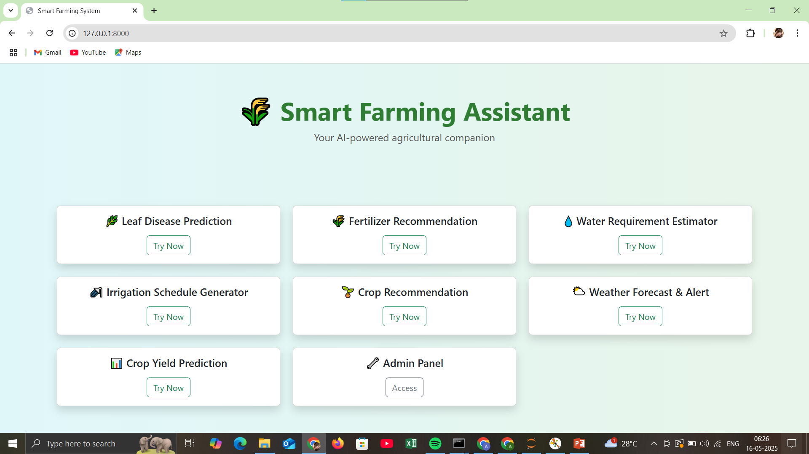
Output

Slide 14
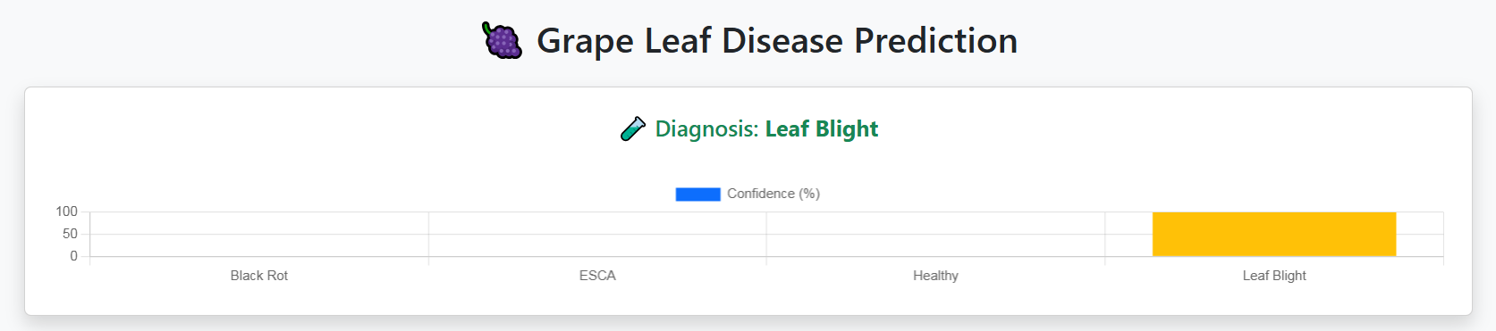
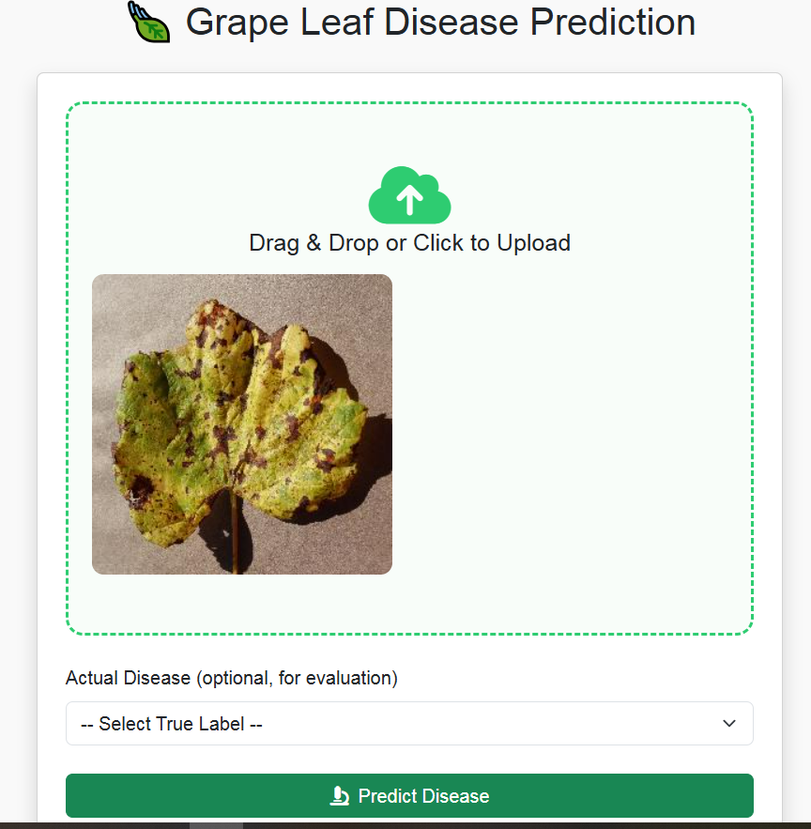
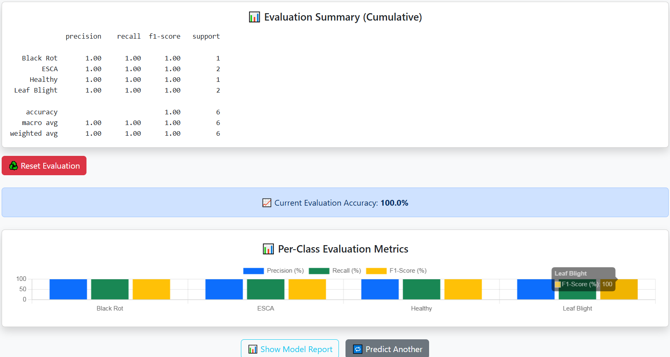
Disease Prediction

Slide 15
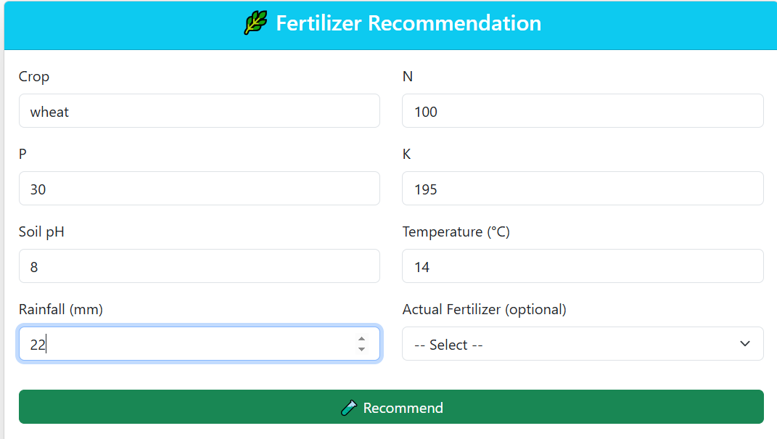
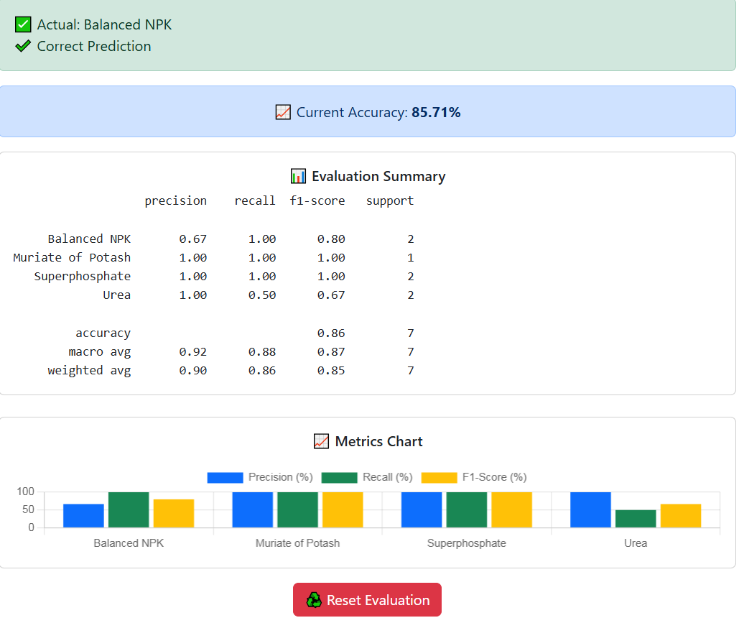

Slide 16
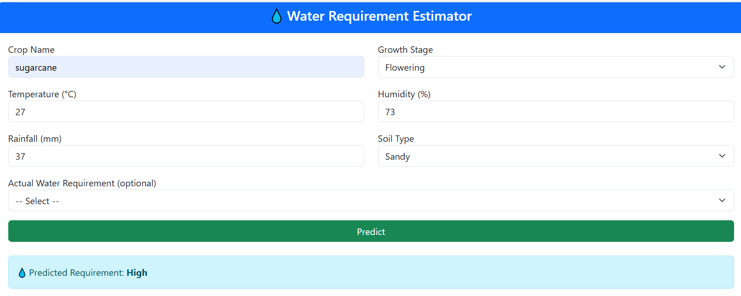
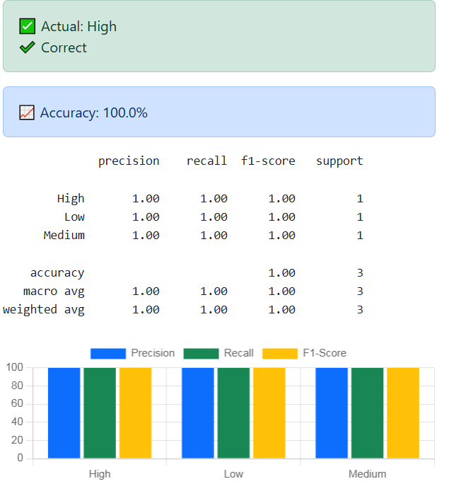

Slide 17
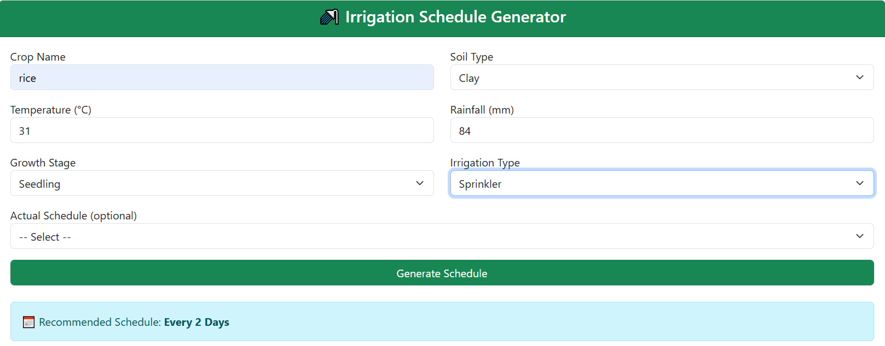
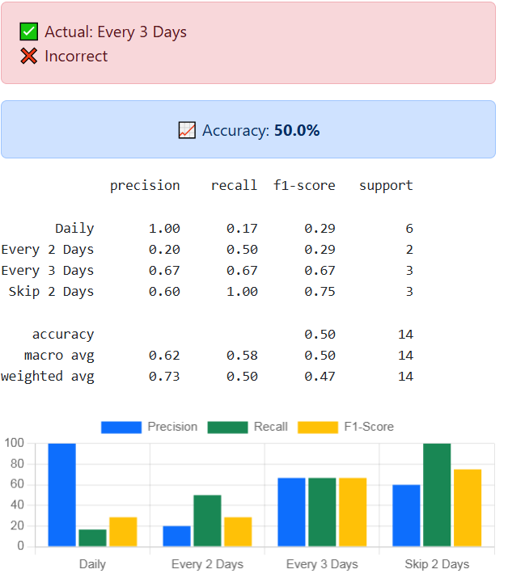

Slide 18
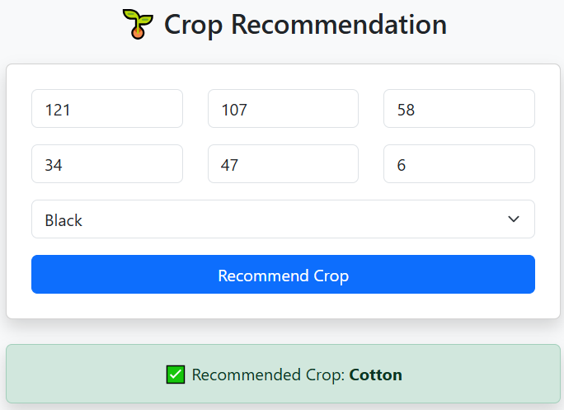

Slide 19
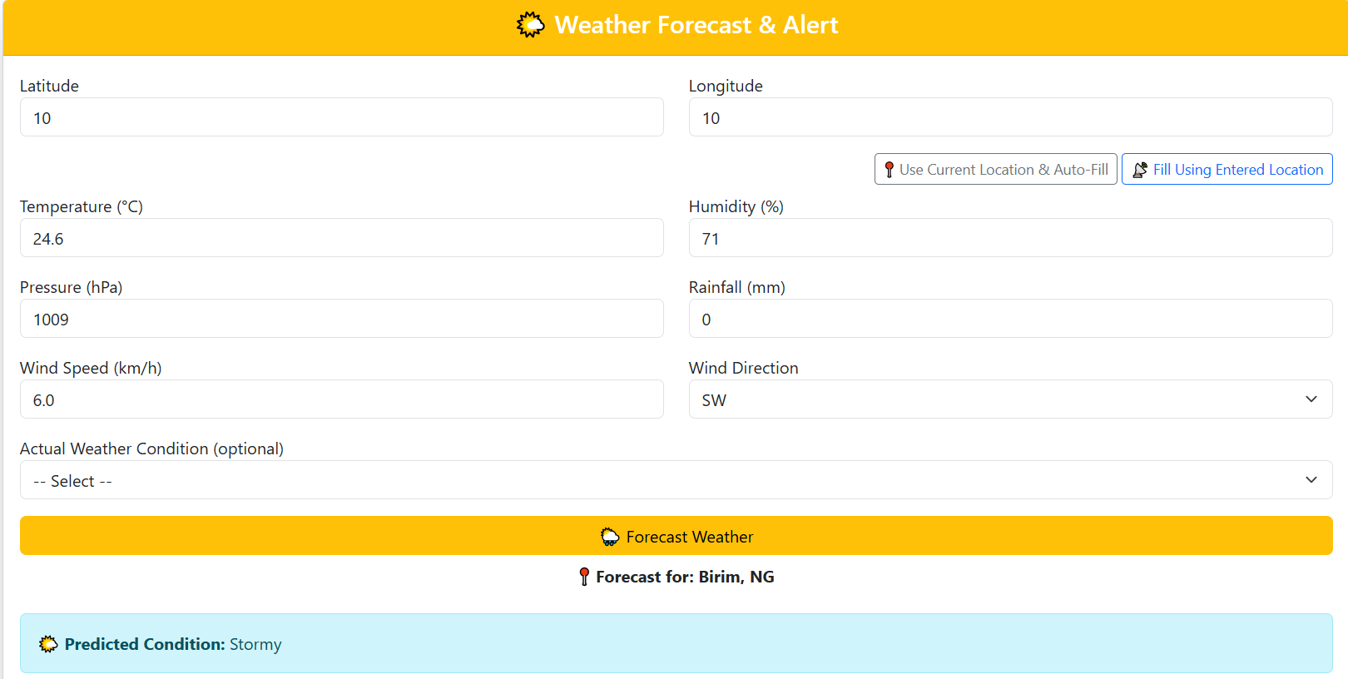

Slide 20
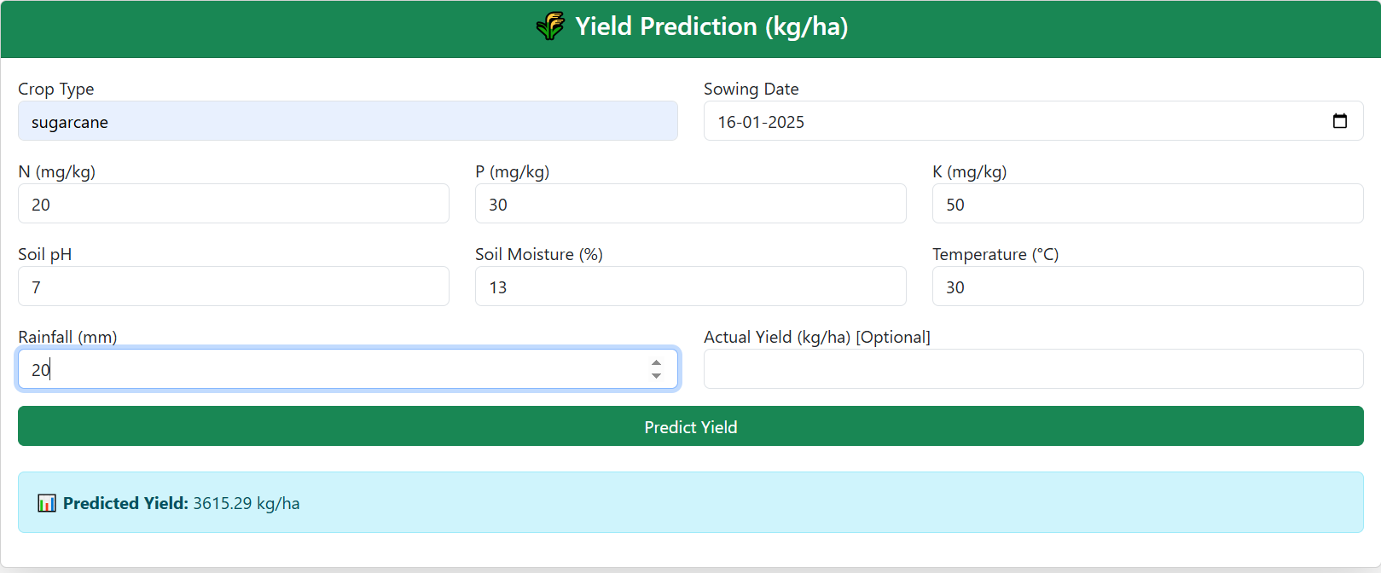
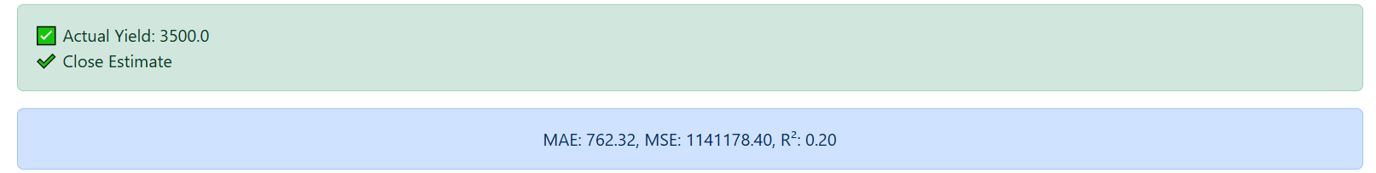

Slide 21
THANK YOU….

